Slide 1

Clubs and Societies' Finance

Slide 2

Club and Society Finance Overview
Society Subscription Fund
Society Raises Funds
  Membership Subscriptions – credited weekly
  Events – ticket income is received AFTER the event
  Sponsorships - credited when received
  Donations – credited when received
This money is paid into your society fund account via the SU bank. It is funds held in our books – there is no direct access to the money.
Society Spends Funds
  Events & Socials
  Other e.g speaker
Society expenditure is made by a member spending their own money or by asking the SU to pay an invoice or by asking the SU to order and pay for goods on the society’s behalf.
The society submits receipts/invoices to the SU using our Student Group Finance System and the money is refunded to the society member/the invoice is paid/the goods are ordered and paid for.

Slide 3
Club and Society Finance Overview
Society Grant Fund
Society applies for Development Grant from the SU
  Specific expenditure only
  VAT not reclaimable – society pays full amount
This money is paid into your society grant fund account via the SU bank. It is funds held in our books – there is no direct access to the money.
Society spends Development Fund
  Specific agreed expenditure
  Must be approved before committing to the expenditure
  Expenditure on food must not exceed £100 and the event should be open to everyone
Society grant expenditure is made by a member spending their own money or by asking the SU to pay an invoice or by asking the SU to order and pay for goods on the society’s behalf.
The Society submits receipts/invoices to the SU using our Student Group Finance System and the money is refunded to the society member/ the invoice is paid/the goods are ordered and paid for.

Slide 4
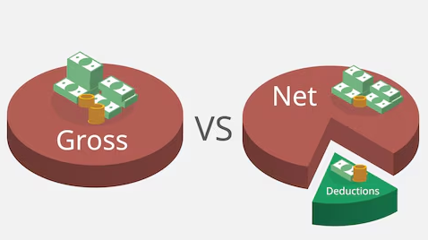
Club and Society Finance Overview
VAT
For Vatable goods, the purchase cost will be made up as follows:
NET Price £100.00 100%
VAT ADDED £20.00 20%
GROSS Price £120.00 120%

Slide 5
Club and Society Finance Overview
Income
The following income is subject to VAT
  Membership Subscriptions
  Tickets for Events
  Sponsorship
This means that your society will receive the income NET of VAT of 20%
So if your membership is £5.00 this represents 120% - The membership price 100% plus VAT at 20%
Your society will therefore actually receive £5.00 / 120% x 100% = £4.16
If you secure sponsorship of £350 your society will actually receive £350 / 120% x 100% = £291.66

Slide 6
Club and Society Finance Overview
Expenditure
Society expenditure is subject to VAT
The SU can reclaim the VAT so your society will only be charged the NET amount of your expenditure
If your society makes expenditure with a total cost of £650.00 including VAT (120%)
Your society will be charged £650 / 120% x 100% = £541.66
This will only be the case IF YOU SUBMIT A VALID VAT RECEIPT FOR YOUR EXPENDITURE.
Without the VAT receipt the SU is unable to reclaim the VAT and will have to charge your society £650.00

Slide 7
Club and Society Finance Overview
Some Things to Do
Always include a full VAT receipt if possible – ask the supplier.
Keep records of your income and expenditure so that you are aware of your society balance. Use the budget template you will find online.
Check with the SU before you commit to expenditure if you are unsure.
If you are approving other member’s reimbursement claims, do it in good time so that they are not out of pocket.
Use the Event budget template for large events. This type of event and the budget relating to it MUST be approved by the SU before any expenditure can be made.

Slide 8
Club and Society Finance Overview
Some things NOT to do
Never pay society money into your own bank account (e.g funds raised).
Do not give the SU bank account number to anyone who has agreed to give your society funds.
  Sponsorship and Donations – follow the procedure which you will find in your handbook.
  Cash raised – to be taken to the SU office and counted there. See your handbook.
Never sign contracts on behalf of the society. Send to the SU.
Fundraising for UK Registered Charities only and seek their permission in writing as per your handbook.

Slide 9

Club and Society Finance Overview
An Introduction to Student Group Finances (SGF)
SGF allows committee members of societies and members of sport clubs to submit finance requests.
To access SGF - Login to the citystudents.co.uk website and then go to your society/sport club page.
Scroll to the bottom of the page and click on ‘Finance requests’.
Step by Step instructions are available on the SU website.
3 Finance Requests:
1) Money Request - reimbursement of expenses or request for the Students’ Union to pay a supplier invoice.
2) Purchase Request – for the Students’ Union to place the order and process the payment.
3) Sales Invoice – for the Students’ Union to raise a sales invoice for income. For example, sponsorship or donation.

Slide 10
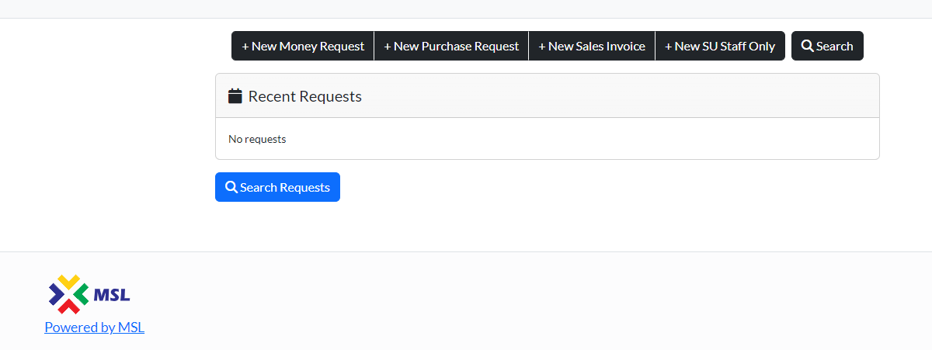
Club and Society Finance Overview
Step by Step instructions are available on the website.
Dashboard

Slide 11
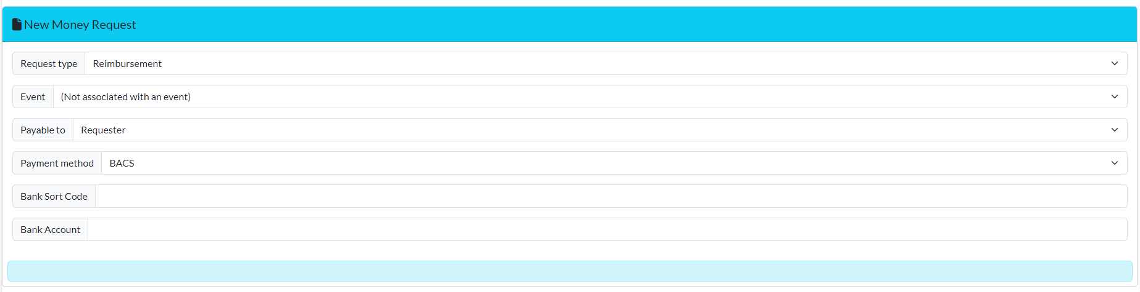
Club and Society Finance Overview
New Money Request – There are two types of Money Requests.
1. Reimbursement
Select this if you have paid for something already and wish to claim the money back.
2. Pay Supplier Invoice
Select this if you need the Students’ Union to pay an invoice directly to the supplier, on behalf of the Society/Club. The invoice must be addressed to City Students’ Union Northampton Square, London, EC1V 0HB.

Slide 12
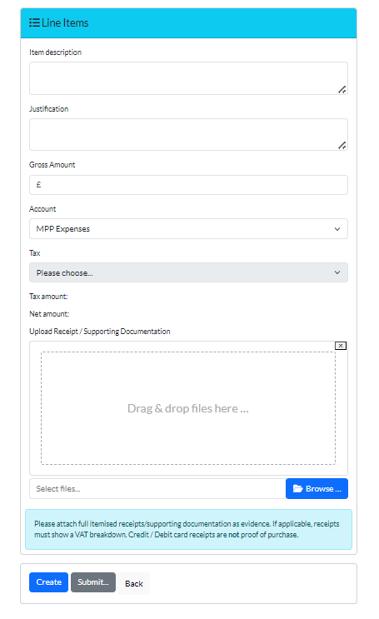
Club and Society Finance Overview
DOs and DON’Ts
Supporting documentation must be uploaded to support your request.
Reimbursements - Create a line item for each individual receipt.
Reimbursements – Multiple lines can be added to a request.
Reimbursements - Foreign currency transactions must be supported by a conversion rate calculation.
Pay Supplier Invoice - The invoice must be addressed to City Students’ Union
Reimbursements - Do not create a new request for each receipt.

Slide 13
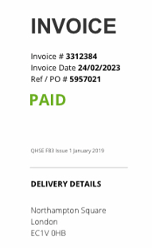
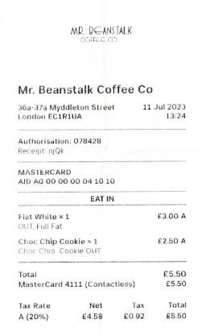
Club and Society Finance Overview
Receipts and Supporting Documentation
All finance requests must be supported by correct documentation.
Valid Documentation - A valid receipt/invoice must show:
Date of the purchase
Name of the supplier
Item(s) purchased
Cost of the purchase (including a VAT breakdown and VAT registration no., if applicable)
Supplier invoice must be marked as paid or supported by proof of payment
Journey summary for travel expenses

Slide 14
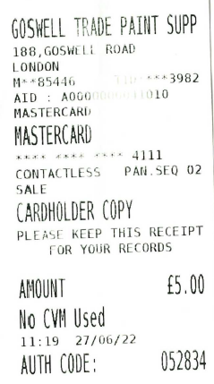
Club and Society Finance Overview
Receipts and Supporting Documentation
All finance requests must be supported by correct documentation.
Invalid Documentation - Requests with invalid documentation will be rejected.
Faded receipts
Card transaction only receipts
Bank transaction screenshots
Missing information

Slide 15
Club and Society Finance Overview
Receipts and Supporting Documentation
All finance requests must be supported by correct documentation.
Sales Invoice Request
Valid Documentation – Sponsorship
Sponsorship contract signed by the sponsor and appropriate member of the Students’ Union
Valid Documentation – Donation
A letter/email from the organisation (or department) with the following information:
- Donor’s name
- Donor’s address
- The following text: “We are pleased to donate the sum of £xxx to City Students’ Union *insert society name*. This is a donation and we expect nothing in return.”

Slide 16
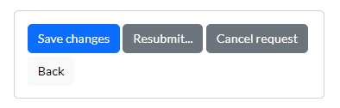
Club and Society Finance Overview
Approval Workflow
The requests will usually follow the following process –
1. Member submits a finance request.
2. President/Finance Officer/Captain approve the request.
If you are the president submitting a request, it will need to be approved by your finance officer, and vice versa.
3. SU Communities/Sports Team approve the request.
4. Finance Team make payment or raise a sales invoice for income.
Referred requests
Please amend/correct or provide additional information and then resubmit the request through the approval workflow by clicking on Resubmit

Slide 17
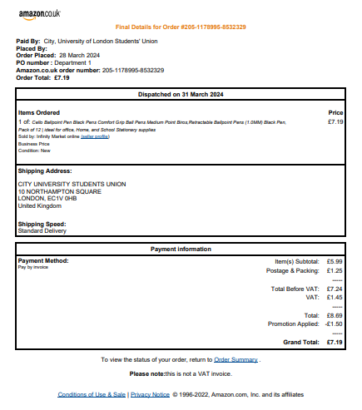
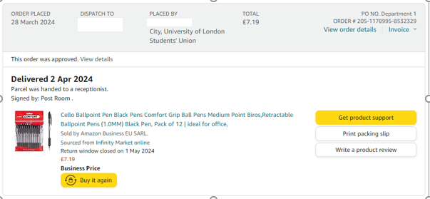
Club and Society Finance Overview
Example 1 – VAT cannot be claimed on order confirmations.

Slide 18
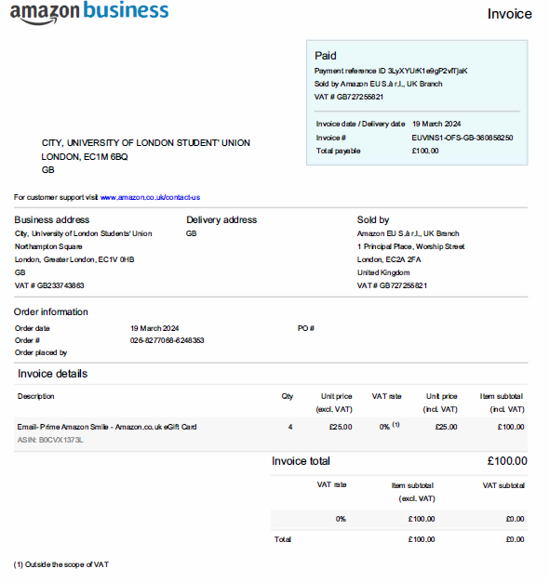
Club and Society Finance Overview
Example 2 – Valid VAT document
Supplier Name
VAT Number
Date
Confirmation of Payment
Description of item purchased
VAT Breakdown

Slide 19
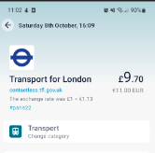
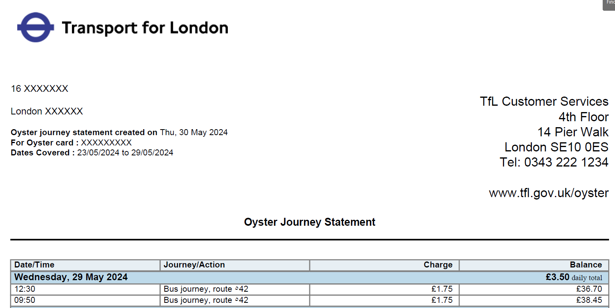
Club and Society Finance Overview
Example 3
Screenshots are not accepted Journey details must be provided
Evidence must show the date of travel, a journey summary and the price

Slide 20
Club and Society Finance Overview
Thank you.

