Slide 1
Navigating the External Speakers Process
5th June

Slide 2
Overview
In this session you will learn about:
External Speakers Policy and Freedom of Speech
External Speakers Process
When to refer an external speaker
How the Union will support you to plan external speaker events
Useful links:
External Speakers Policy
City’s Code of Practice on Freedom of Speech
Societies Handbook
Society Committee Hub

Slide 3
So, what is an external speaker?
Internal speakers are staff or students who are part of City, University of London.
External Speakers are anyone not associated with City, University of London and will be speaking at your event.

Slide 4
External Speakers Policy
Student leadership is fundamental to our Union. As a Union we are committed to empowering event organisers to make the most of their educational opportunities and skills to explore, debate and challenge issues, including those that may be considered controversial, whilst supporting them in fulfilling their legal responsibilities.
Freedom of expression and freedom of speech are basic human rights to be protected and are protected by law. The external speaker’s policy enables the Union to balance multiple legal duties including Union policy, charity commission guidance and the Higher Education (Freedom of Speech) Act.
We have processed nearly 100 external speaker
requests this year! Societies have invited politicians,
ambassadors, authors, poets, business leaders,
musicians and much much more!
External speaker events can be highly engaging and
interesting for your members. The policy outlines the
process which must be followed by societies, the
Union and City in relation to external speakers.

Slide 5
Office for Students and Freedom of Speech
The Higher Education (Freedom of Speech) Act was introduced by the government in an effort to ensure that people at universities in England can freely express their opinions and ideas.
The legal definition of freedom of speech here is:
"the freedom to impart ideas, opinions or information (referred to in Article 10(1) of the Convention as it has effect for the purposes of the Human Rights Act 1998) by means of speech, writing or images (including in electronic form)."
The new duties require universities and students' union's to ensure students right to freedom of speech is secured. The new legislation protects freedom of speech within the law. This means that speech is protected unless it contravenes some other law. It is not, therefore, necessary to point to a specific legal basis for particular speech. Rather, the starting point is that all speech is permitted unless it is restricted by law.

Slide 6
Office for Students and Freedom of Speech
In order to ensure that the Union meets the new regulation will produce a new code of practice outlining the students’ union’s values relating to freedom of speech and an explanation of how those values uphold freedom of speech. This will be published and made known to students before the start of next term.
If you have a complaint relating to freedom of speech, you should firstly make a
complaint to the students’ union. The process for this is covered in the Union’s
complaints policy.
The Office for Students (OfS) operates a free speech complaints scheme. Under that
scheme, the OfS can review complaints about free speech from members, students,
staff, applicants for academic posts and (actual or invited) visiting speakers.
Information about the complaints that the OfS can review is available on its website

Slide 7
Step 1: Events form
For external speakers, the first step is to complete an events form. The events can be found on the Committee Hub and allows you to provide all your event information event via one online form. This form then comes to us, and your form will be reviewed by a member of the Communities Team.
The form will ask if your event has an external speaker. The form will then ask for links to relevant pages, for example the speaker’s LinkedIn page, or any relevant news articles written by or about the speaker.
You must submit a minimum of three links to relevant pages and all the required contact information.
You should complete the events form in as much detail as possible.

Slide 8
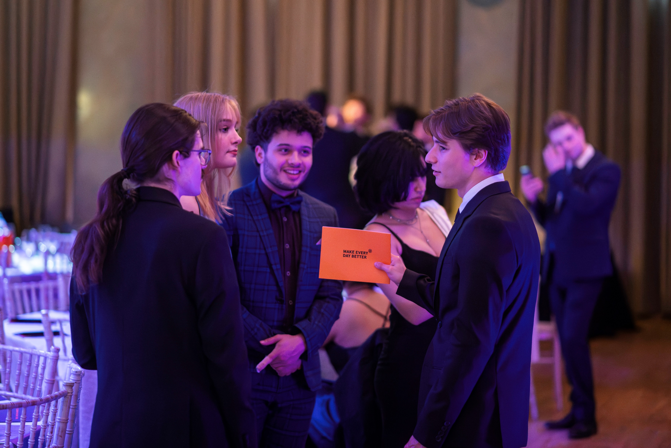
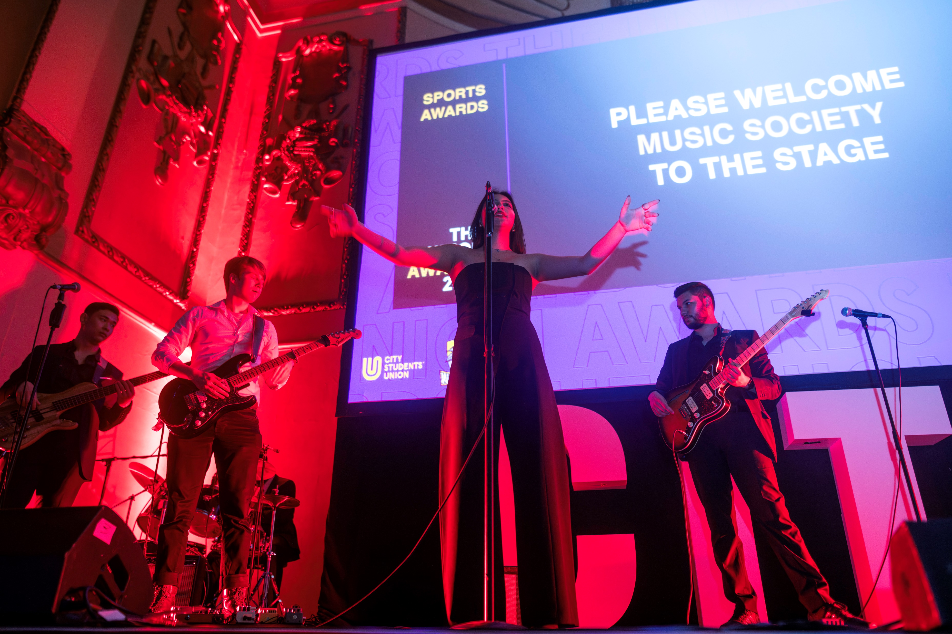
Step 2: Referral
When you complete the external speaker section of the form, you will be asked whether you want to refer the speaker for a more detailed evaluation.
You should refer the speaker if you answer yes to any of these questions:
a) The speaker or topic has attracted controversy in the past.
b) The event or speaker is likely to attract media attention/interest.
c) The external speaker is on a tour across several institutions or organisations.
A referral does not mean your event will be cancelled or rejected, it just allows us to help make sure the event can go ahead safely and be as successful as possible for your student group.

Slide 9
Step 2: Referal
If you do not self-refer the speaker, but our initial evaluation concludes that they meet one or more of the criteria above, we will refer them for a further evaluation. Therefore, if you think the speaker meets any of the criteria, it saves everyone time if you self-refer in the first instance and reduces the risk your event will be postponed or cancelled.
For speakers that are not referred, we may decide they need a more detailed evaluation if any of the following occurs:
a) Our Google search shows the speaker to be the topic of mainstream media coverage
b) Our Google search shows that the speaker is on tour across a number of institutions
c) Our search shows that the speaker has social media accounts with more than 10,000 followers
If you do not refer your speaker and they meet one or more of the requirements above, we will simply refer them ourselves.

Slide 10
Step 3: Risk
Once we have conducted our evaluation , we will give your event either a ‘low’ or a ‘high’ risk rating. Please note that high risk does not mean the event will be cancelled or the speaker rejected, just that we will help manage the risk and ensure the event can go ahead!
If your event is considered high risk, mitigations may be added to ensure the event can go ahead safely. These mitigations will help your event run smoothly, and should anything happen, support you to manage any issues that arise.
The risk rating is not placed on the individual person invited but the conditions of the event that require mitigations to ensure attendees are free from harm.

Slide 11
Step 3: Risk
Risk will be identified as low or high in relation to the following categories:
a) The speaker is linked to a proscribed organisation as defined in the Terrorism Act 2000.
b) The likelihood of the speaker’s presence at the event resulting in a platform for the expression of promotion of extremism or radicalisation as defined in the Charity Commissions Guidance.
c) The potential for the speaker’s presence to cause breach of the peace and / or fear or alarm to students, staff or other members of the public.
d) The potential for the speaker’s presence at the event to cause the Union to be in breach of its Equality, Diversity and Inclusion Policy.
e) The potential for the speaker’s presence to give concern for the health and safety of students, staff or members of the public.
f) The Union’s requirement to uphold the freedom of speech as per the University’s Code of Practice in relation to the Education Act, as set out in our Code of Practice with City University.
g) The opportunities and risks to the Union’s reputation of the speaker’s presence at a Union event.
h) The need for the Union to be seen to be and to be independent from party politics as defined in the guidance on Campaigning and Political Activity By Charities (CC9).
i) Any other risk to the wider legal framework in which the Union operates.

Slide 12
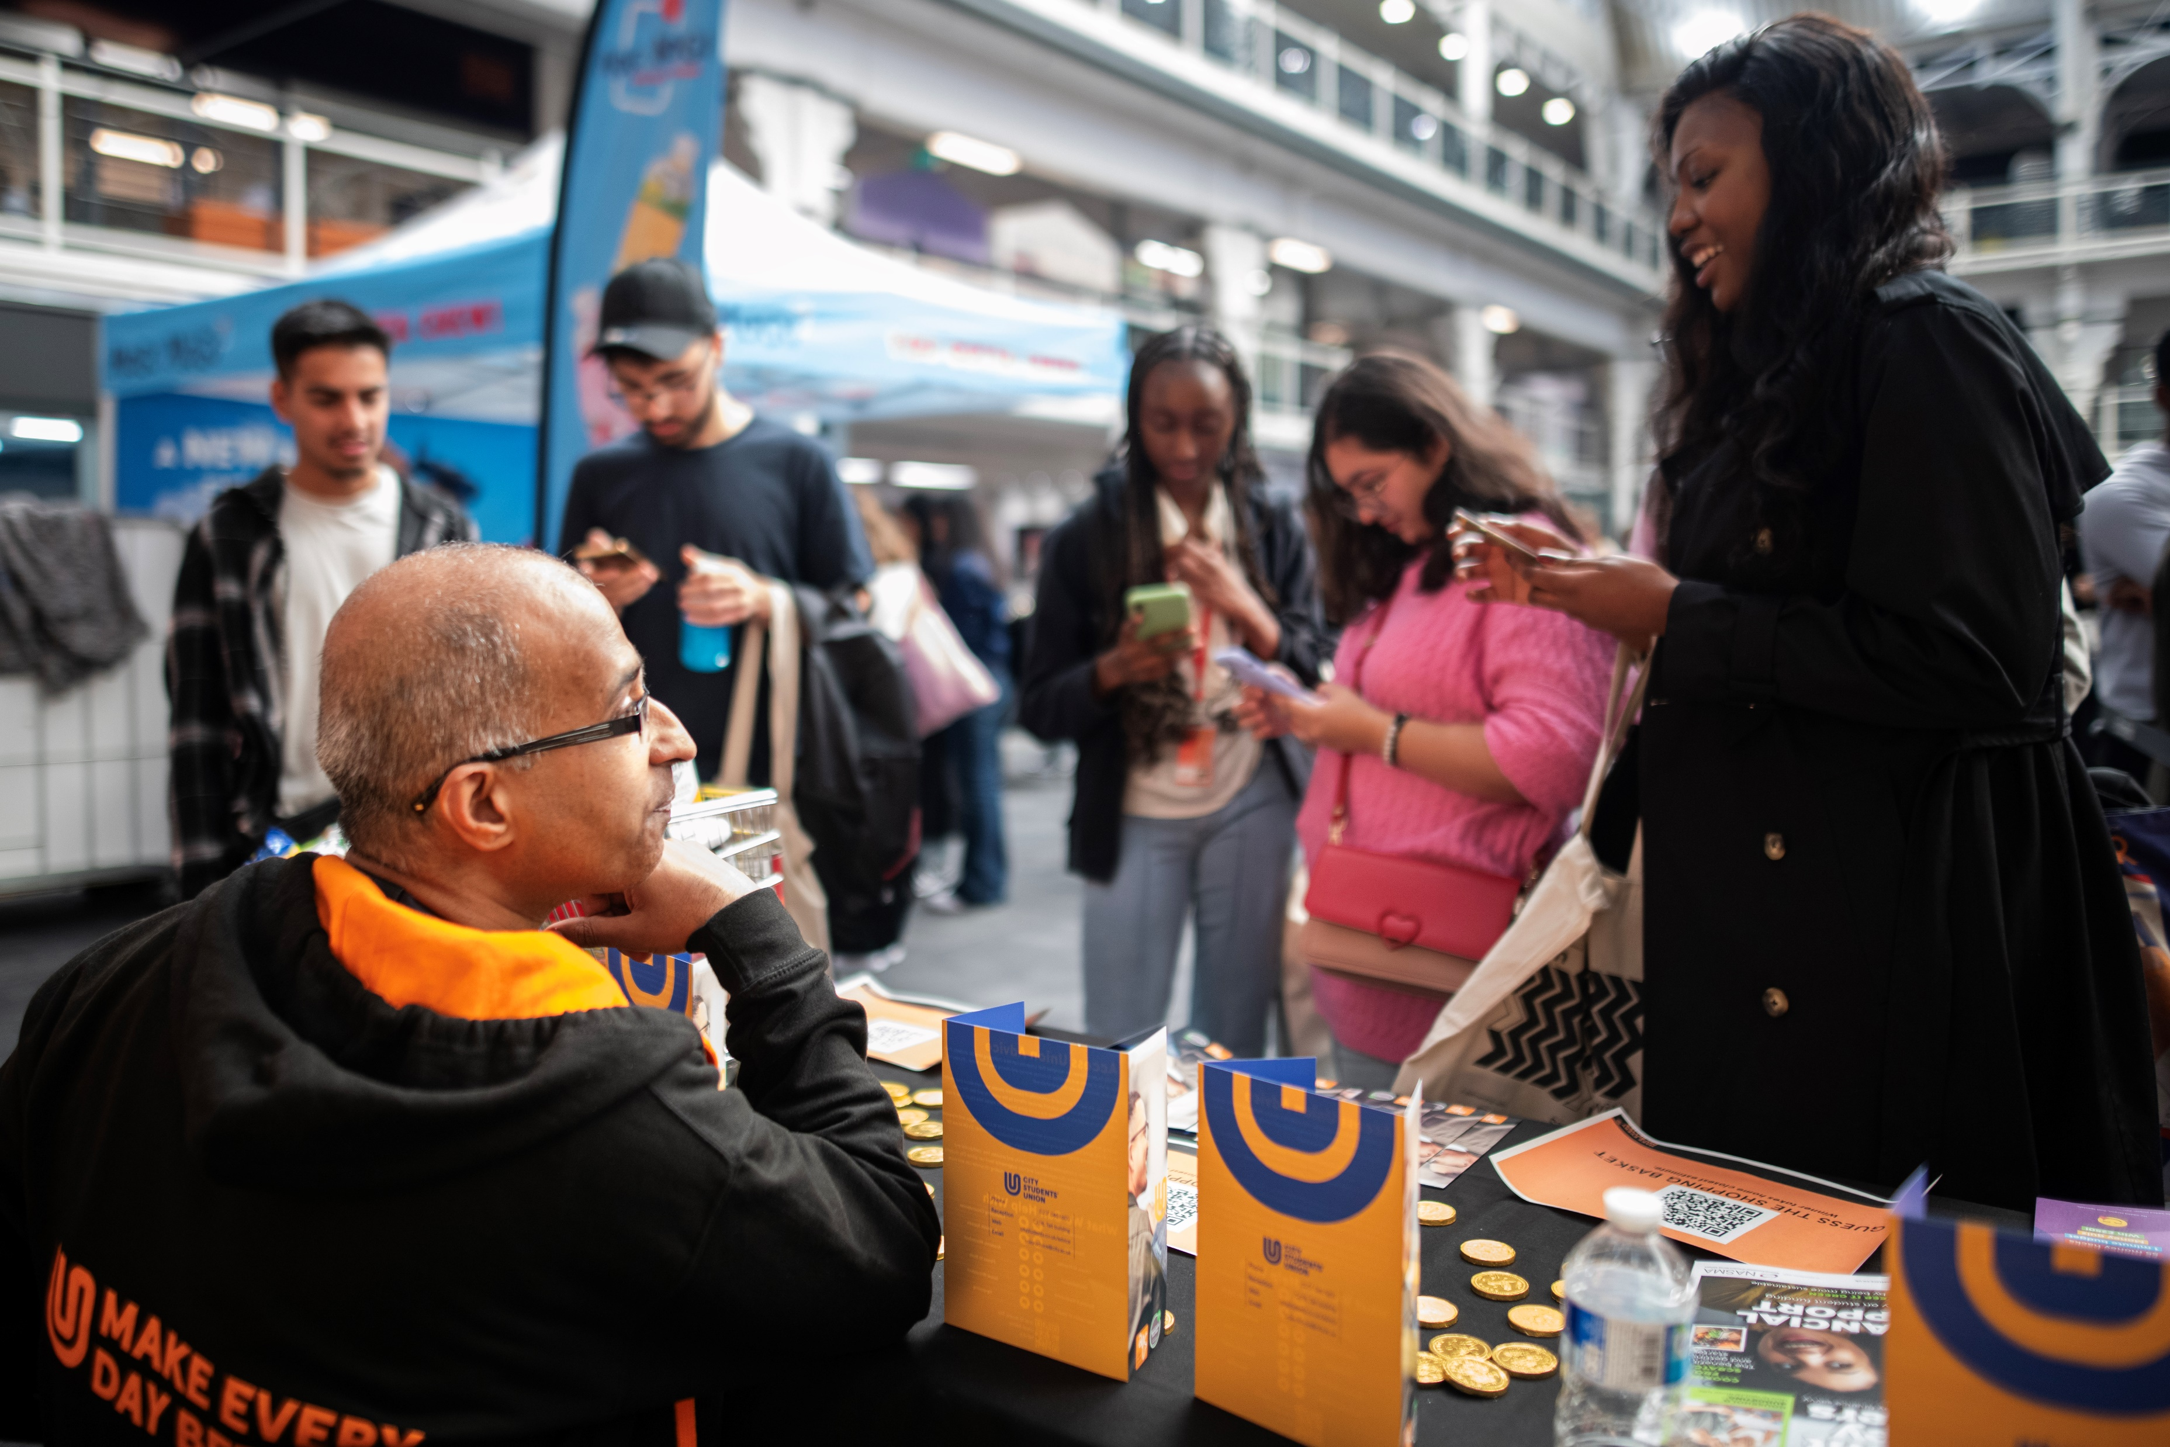
Step 3: Risk
After a referred speaker is evaluated, the Union may make one or the following recommendations:
a) To permit the external speaker to speak at the event with no further regulatory steps.
b) To permit the external speaker to speak at the event subject to the implementation of regulatory steps designed to reduce the event risk.
c) To not permit the external speaker to speak at the event
If a speaker is not permitted to speak at a Union event, then it will be reported to the Deputy Chair of the Board of Trustees within one working day of such a decision being taken.

Slide 13
Step 3: Risk
Regulatory steps for referred events include, but are not limited to:
a) The event is ticketed via the Union’s website.
b) Attendees to be restricted to City only.
c) That City security be notified of the event taking place.
d) The event be recorded by an independent body or by lecture capture.
e) The event is observed by the Union, City, or third-party officials. The Union, City or third-party officials reserve the right to stop the event if any of the Unions policies or legal duties are contravened before or during the event.
f) Any high-risk events promoting a particular view includes an opportunity to debate or challenge that view.
g) The chair to be agreed by the Union in advance and any changes to the chair will not be permitted later than 5 working days prior to the event.
h) A copy of all, or part of a speech to be delivered to be submitted to the Union in advance. i) Where there is significant tension around a speaker or topic, to place limitations on promotional and or supporting materials to reduce risk of intimidation.

Slide 14
Step 4: University approval
All referred external speakers will be reviewed by City. City’s Code of Practise on Freedom of Speech outlines their process for external speaker's process. The university will undertake it’s own process.
City will inform the Union of their decision, the Union will communicate that with event organisers.
During the 15 working days the Union will work with the event organisers and City to make the right decision on whether a speaker can be approved and whether
any regulatory steps are required as a condition of the event
approval. This process, where possible, will be done in
collaboration with the society.
Appeals for referred speakers should be made in writing to the
students’ union president. Appeals are not permitted for non
referred speakers.

Slide 15
TOP TIPS
Tip 1: If you're thinking of inviting a speaker onto campus, reach out to the Communities Team and we can support you to complete the requirements of the External Speakers Policy.
Tip 2:If in doubt, you should refer the speaker to be reviewed by the Union.
Tip 3: You will need an event-specific risk assessment for external speaker events. You can find this on the Committee Hub. This should be submitted with your events form. You should update this with any additional mitigations put in place.
Tip 4: For all external speaker requests, we will need 15 working days notice. The 15 working days starts when the Union has all the information requested on the events form from the event organisers. This includes information about the event, the room requirements, and the external speaker. You should include as much detail as possible in your events form.

Slide 16
TOP TIPS
Tip 5: The external speakers process covers all society events both on campus and off campus, in person and online.
Tip 6: No meeting, event or activity (online or otherwise) involving an external speaker may be published or promoted until the External Speaker Process is complete. You should factor this into your timeline for planning your event.
Tip 7: Think BIG about who you invite to campus! For large scale events, please do ensure you give the Union as much notice as possible to enable us to support you effectively.
Tip 8: Some speakers may request travel or accommodation expenses reimbursed. You should look to cover these either through ticket sales, society development fund or memberships.

Slide 17
Q+A

Slide 18
Activity: External Speaker Scenarios

